Slide 1
Design a Framework
Presented By:
Keval Pithva (113318)
Chetan Bhati (113321)
Ravirajsinh Vaghela (113342)
Guided By:
Dr. Ajay Parikh

Slide 2
What is a framework?
A set of co-operating classes that makes up a reusable design for a specific class of software. A framework provides architectural guidance by partitioning the design into abstract classes and defining their responsibilities and collaborations.

Slide 3
A framework has certain responsibilities in the functioning of an application. These responsibilities are;
Menu Management
Form Management
Security Management
Communication Management
Data Access Management

Slide 4
Build up a Framework

Slide 5
STEPS
Establishing Requirements
Determining the Scope of the framework
Abstract Design
Identifying the Design Pattern
Designing Class Hierarchy

Slide 6
Establishing Requirements
First step is identifying the problem you want to solve.
If you set out to solve the wrong problem you will, most assuredly, end up with a solution that is wrong for your needs.

Slide 7
Trying to fit an application into a framework that is working against you is not a pleasant task.
Regardless to whether you are building your own framework or evaluating one of the many commercial frameworks available, you need to know your requirements clearly if you want any chance of being successful.

Slide 8
What Kind Of Applications Do You Build?
Since the framework supplies the skeleton for your application, the type of application will influence the way the framework should be structured.
Specify(Identify) the application Domain
Ex. accounting, decision support, line of business, research, marketing, scheduling, and others.

Slide 9
Each of these application types would require a different type of interaction with the user.

Slide 10
What Kind Of Data Sources Do You Require?
You may be using one or more of the following data sources in your applications
local DBFs
Internet/Intranet data sources.

Slide 11
What Kind Of User Interface Do You Use?
Your applications may present themselves to your users in one of a variety of ways.
There are process centric, data centric, and goal centric approaches to this presentation.

Slide 12
Process centric applications focus the user on the processes that are done like creating invoices, or applying cash receipts.
Data centric applications focus on the data
Finally, goal centric applications focuses the user on their goals and presents activities that are goal directed.

Slide 13
Determining the Scope
A framework is NOT an application wizard!
You need to determine for what the framework is responsible and for what the developer is responsible.
Don’t use or build a framework that makes the developer work harder to get the result they want.

Slide 14
Abstract Design
Log Manager
Validation
Login Framework
Session Manager/
Authentication
Exception
Handling
Cryptography

Slide 15
Designing Class Hierarchy
Every branch in the class tree should start with a single abstract class definition that I will call the root class.
This root class should have no code in it at all, but rather should be the class where we add the properties and methods that the subclasses will use to provide the code.
This approach provides the structure for having a clear and consistent public interface to the classes in our class libraries.

Slide 16
Database - Class Diagram
<<Iconnection>>
+getConnection():
Connection
Client
+main():void
Implements
asks
Mysql
+getConnection():
Connection
Sql
+getConnection():
Connection
ConnectionFactory
+getConnection():
IConnection
uses

Slide 17
Exception - Class Diagram
Chain <<abstrct>>
Client
One:int
Two:int
Three:int
+SetNext():void
+messge()void
Main():void
uses
AlNum
NotNull
PwdGT5
+messge():String
+messge():String
+messge():String

Slide 18
Log Manager - Class Diagram
+main():void
Client
-PrintStream
Single
Log Manager()
+getInstance(): Log Manager
+log(): void
Log Manager
returns
Log Manager

Slide 19
Cryptography - Class Diagram
<< Strategy >>
+ getEncrypted() :byte[]
+getDecrypted: String
Client
Cryptography
AES
RSA
DES
-Strategy : stratagy
+getEncrypted: byte
+getDecrypted: Str
+getEncrypted: byte
+getDecrypted: Str
+getEncrypted: byte
+getDecrypted: Str

Slide 20
Qualities of a Good Framework
Simplicity
This simplicity is achieved by giving the parts of the framework clear and consistent interfaces.
The overall structure of the framework must be easy to understand. A well designed framework can be taught to a new developer in a few days at most. Obviously, the details of all of the methods and properties involved are not taught in a few days, but the new developer should be able to understand how the thing works very quickly and then fill in the details as they use it.

Slide 21
Clarity
The behavioral aspects of the framework must be encapsulated.
If the developer must understand the actual code in the framework then there is a definite design problem in that framework.
The public interface for the classes in the framework should be as simple as possible.

Slide 22
Boundaries
A framework has clear and to the point responsibilities
it should meet those requirements and nothing more.
All functionality outside the frameworks boundaries should be handled by the developer.
When a framework crosses the boundary it becomes overly complex

Slide 23
Expandability
It should be easy for the developer to expand the framework by either adding new classes or by sub classing the existing classes.
A framework whose behavior is not easily modified restricts the developer rather than empowering them.

Slide 24
Hooks
One way to provide for expandability is by providing the developer with methods in which they can write code that will affect the behavior of the framework.

Slide 25
Login Framework in Java
Apache Shiro
http://Shiro.appache.org
jGuard -based on JAAS (Java authentication and authorization security). http://sourceforge.net/projects/jguard/
Bouncy Castle for strong encryption and decryption
http://www.jasypt.org/

Slide 26
Apache Shiro
powerful and easy-to-use Java security framework
Open Source
It provides
Authentication
Authorization
Cryptography
session management

Slide 27
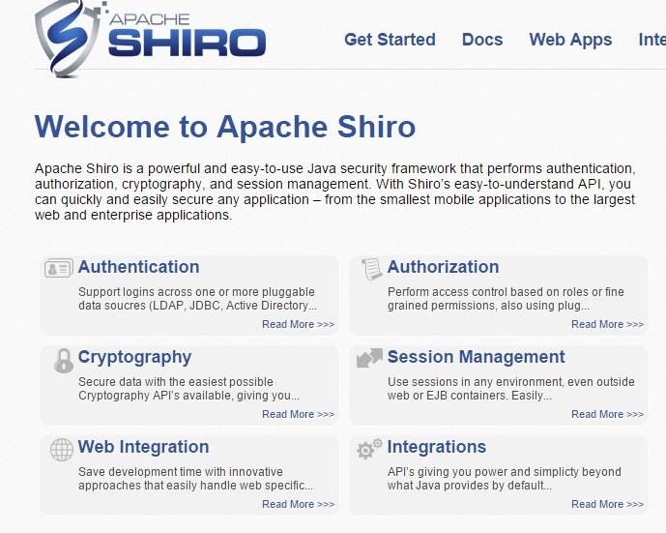

Slide 28
Bibliography
http://www.jamesbooth.com/OOPTopPage.htm(Provide information on framework designing and development)
Design Patterns: Elements of Reusable Object-Oriented Software (provide information about Design Pattern)

